Slide 2
Our mental health
We all have mental health
Just like our physical health, it goes up and down
Having good mental health can help us feel better, sleep better and support us in doing the things we want to do
It can also help us have more positive relationships with those around us

Slide 3
Self-care
We don’t need to wait until we are struggling with our mental health
There are lots of things we can do to protect our mental health and stop issues from getting worse, just as we do with our physical health
Self-care is anything we do on purpose to look after our mental or physical health

Slide 4
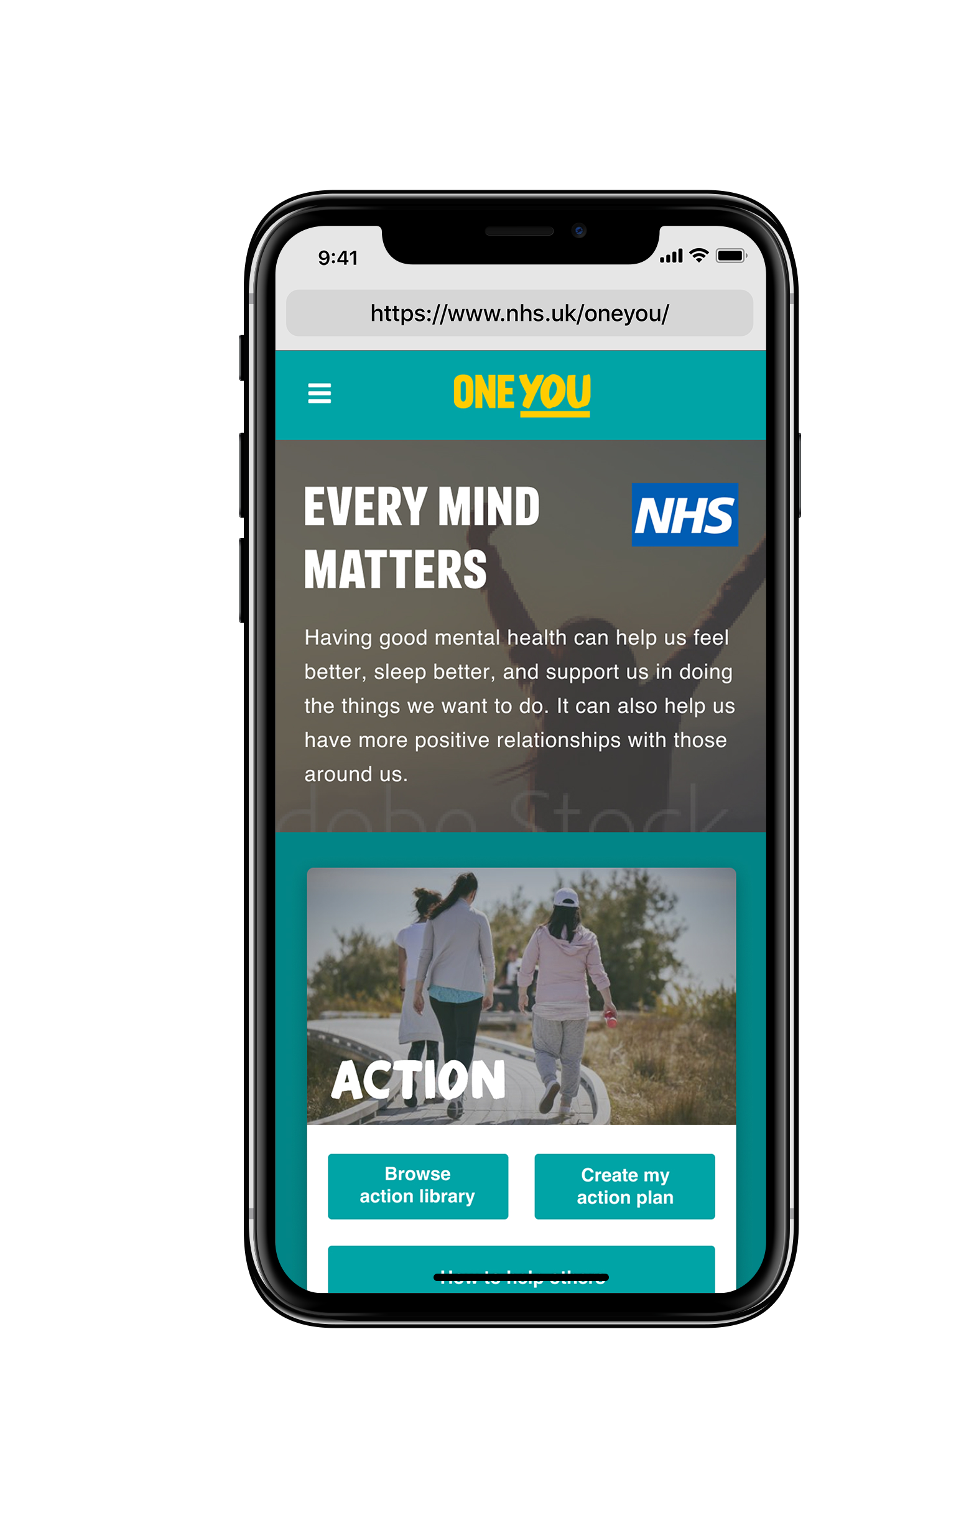
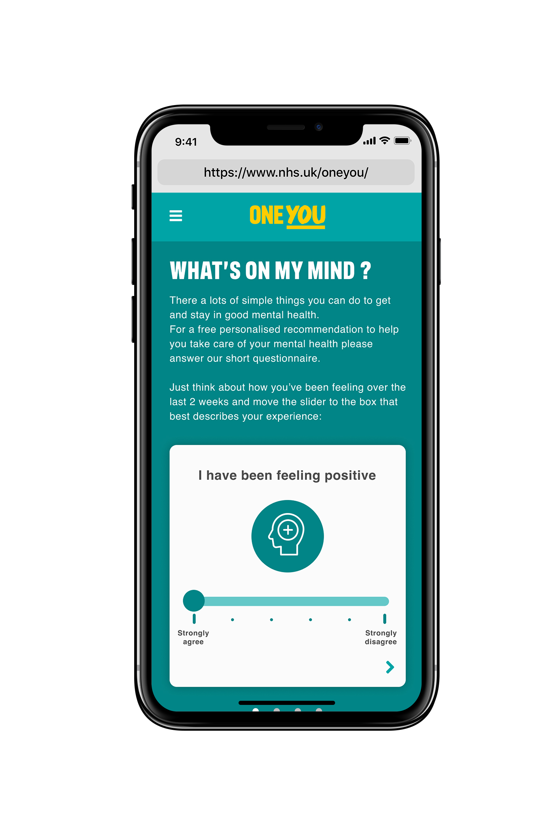
Every Mind Matters
Every Mind Matters is the first national mental health campaign from Public Health England
Expert advice and practical tips to achieve good mental health
Free NHS-approved online tool to help us:
Deal with stress
Boost our mood
Improve our sleep
Feel more in control

Slide 5
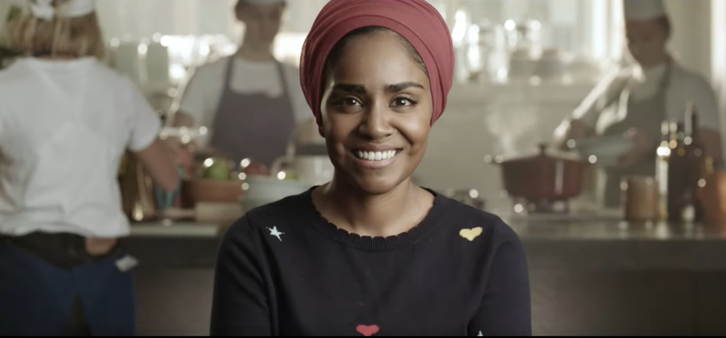
Every Mind Matters
Visit mhfaengland.org/every-mind-matters/#video and play the three minute video

Slide 6
What does self-care mean to you?
Self-care is different for everyone
What do you do for your self-care?

Slide 7
What do you do for self-care?
Spending time in nature
Enjoying a hot drink
Spending time with friends or family
Messaging a friend
Playing sports
Having a bath
Spending time with pets
Going to bed early or having a lie in
Doing something creative
Watching a film

Slide 8
Create ‘Your Mind Plan’ using the Every Mind Matters tool
New evidence-based, free tool
Developed with clinical and academic experts and national mental health charities
Clinically assured by NHS England
Researched among people with a wide range of mental health needs
By using the tool you can create ‘Your Mind Plan’, a set of simple, practical self-care actions you can build into your daily routine to support your mental health and wellbeing
Aims to help us build our mental resilience and help prevent mental health issues from getting worse

Slide 9
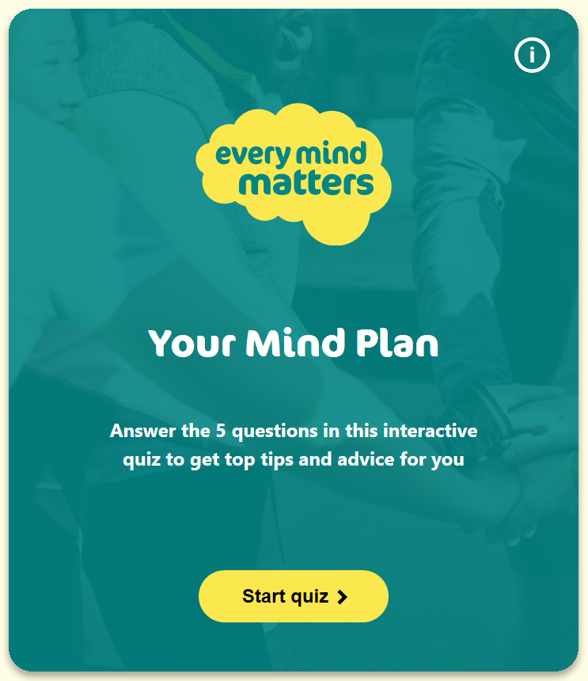
Create ‘Your Mind Plan’ using the Every Mind Matters tool
Visit mhfaengland.org/every-mind-matters/#tool

Slide 10
Your self-care plan
Think of a self-care activity that you will do in the next week
Share with the group, with the person next to you, or make a note for yourself
Visit mhfaengland.org/every-mind-matters
Use the Every Mind Matters tool to create Your Mind Plan

