Slide 1
Making the case for young people’s mental health

Slide 5
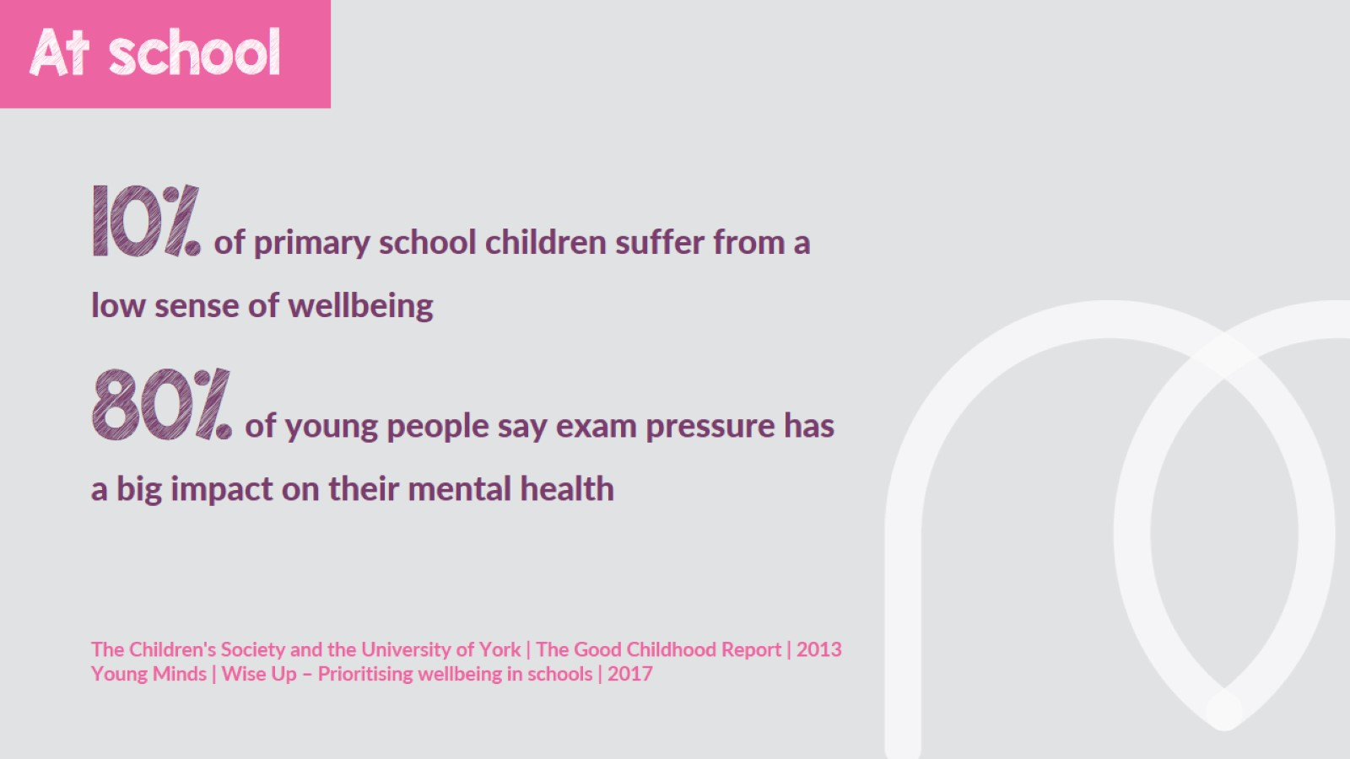

Slide 8
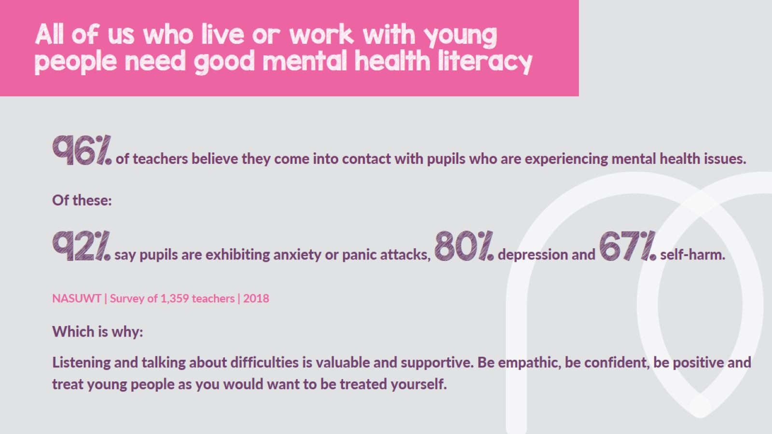

Slide 13
What next?

