Slide 1
Campaign toolkit
Brought to you by Mental Health First Aid England®
© MHFA England 2024

Slide 2
Overview
This campaign toolkit has been developed to support you and your organisation to get involved with My Whole Self, the campaign for workplace culture change.
It includes template email and website copy for you to share with your people, social media banners and signatures, and even guidance on sharing your story with the media.
Whether you take part in My Whole Self Day or throughout the year, we hope you will join us in changing workplace cultures for the better.

Slide 3
Engaging your people

Slide 4
Engaging your people
For My Whole Self to be a success in your organisation, your people need to be on board
To help get the message out there we have developed a suite of content:
Internal email copy that you can edit for use
Signature banners to add to your emails
Social media graphics including a ‘save the date’ which you can use across your digital channels

Slide 5
Email copy
[Organisation name] is proud to be supporting My Whole Self, MHFA England®’s campaign for workplace culture change.
The campaign calls on organisations to empower employees to bring their whole self to work. Bringing your whole self to work means feeling empowered and comfortable to bring all parts of your identity to work, including your background, sexuality, religion, gender, physical and mental health.
By bringing together diversity and inclusion with health and wellbeing, we hope to drive positive transformation in workplace mental health and performance. Teams that feel safe and connected work better together. We want you to feel psychologically safe, seen, heard and valued which is why we have decided to get involved.

Slide 6
Email copy cont.
To mark My Whole Self Day, on [insert date] we will be [insert details of activities that you will be doing and any joining instructions]. If you would like to find out more about the campaign and take a look at some of the resources, visit My Whole Self.

Slide 7
Signature banners
Ask your people to add this to their email signature to demonstrate your commitment to the campaign
E-mail signature

Slide 8
Be part of the conversation online

Slide 9
Be part of the conversation online
We’ve drafted some suggested social media posts so you can share your support for My Whole Self with your online community:​
Don’t forget to share your #MyWholeSelfie as well. You can find instructions here.
How will you celebrate #MyWholeSelf Day on 12 March? Get your free resources from @MHFAEngland's website now and start planning what your workplace can do to empower everyone to bring their whole selves to work https://bit.ly/41j1No0​​
How can we create mentally healthy workplaces? It starts when we can bring our ‘whole self’ to work. On 12 March workplaces across the country will celebrate My Whole Self Day – download free resources now to get involved: https://bit.ly/41j1No0​

Slide 10
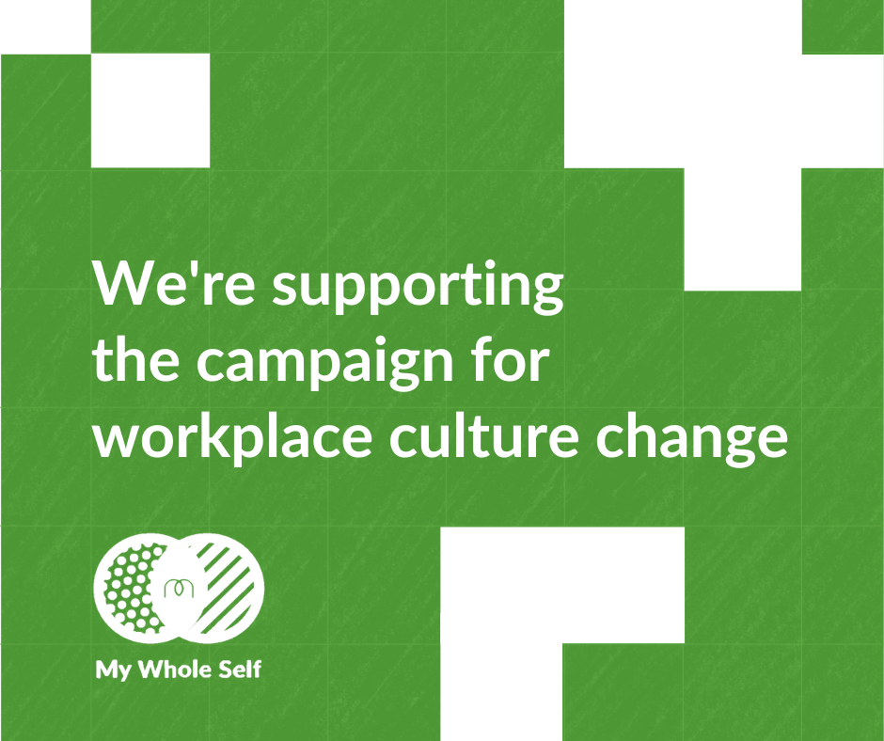
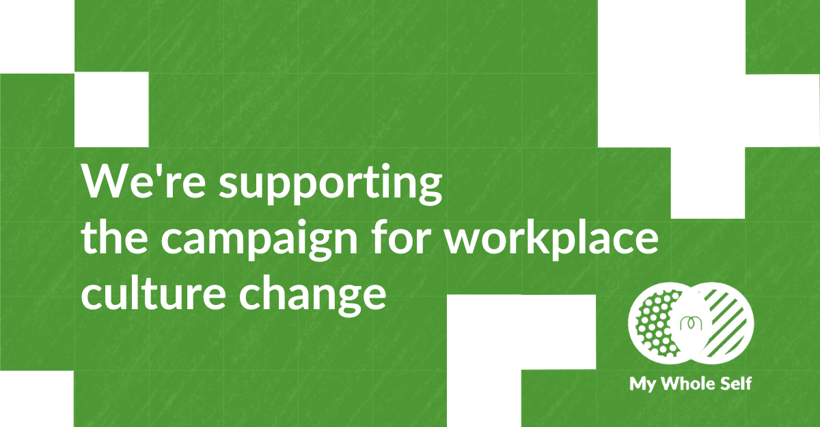
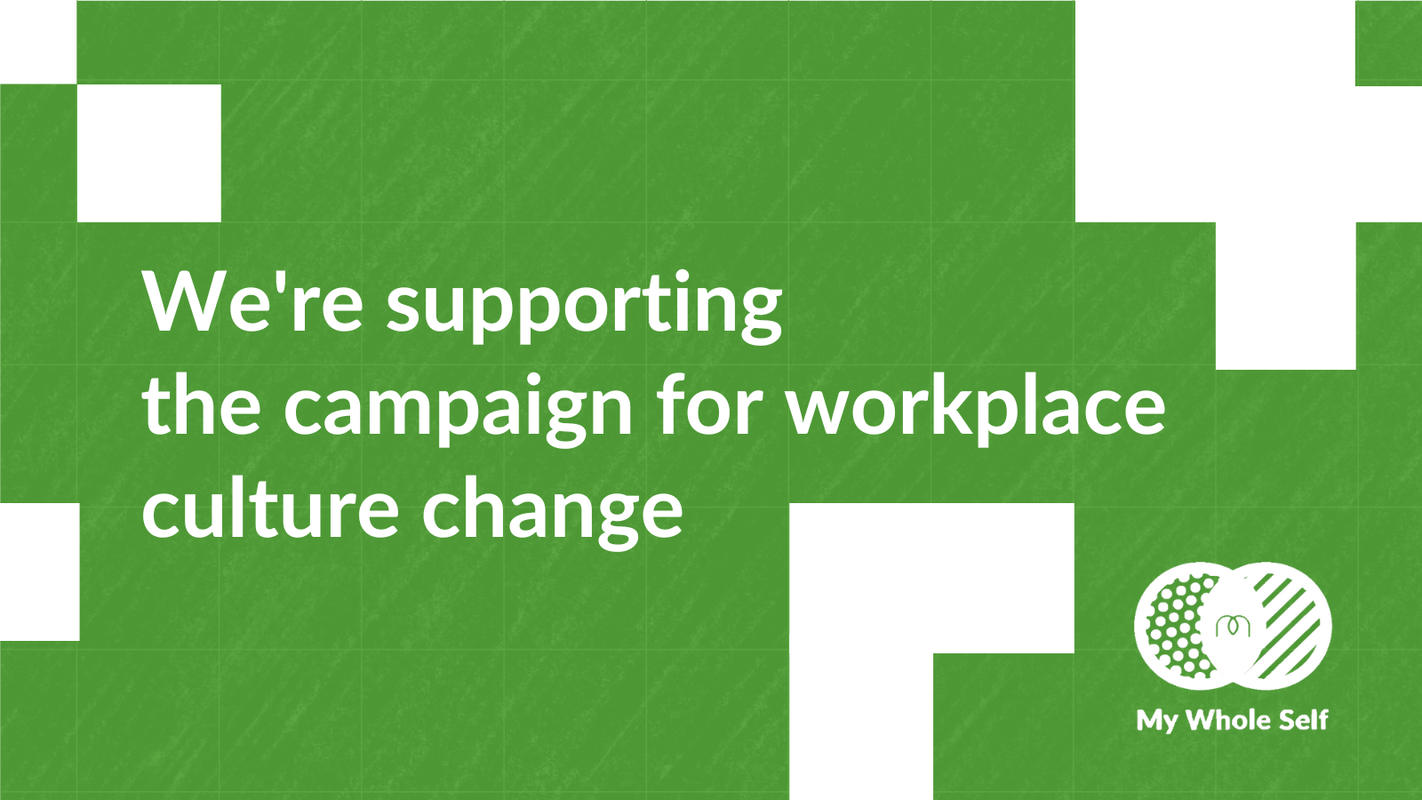
Join the conversation online - use our social cards​
Download these by clicking on the links below.​
Instagram​
LinkedIn​
Facebook​
X​

Slide 11
Share your story

Slide 12
Share your story
We want you to celebrate your efforts to change workplace culture
The following can help you share your stories and with others:
Internal email copy that you can edit for use
Website copy
Blogs
Template press release

Slide 13
Website copy
[Organisation name] is proud to be supporting My Whole Self, MHFA England®’s campaign for workplace culture change.
The campaign calls on organisations to empower employees to bring their whole self to work. Bringing your whole self to work means feeling empowered and comfortable to bring all parts of your identity to work, including you background, sexuality, religion, gender, physical and mental health.
By bringing together diversity and inclusion with health and wellbeing, we hope to drive positive transformation in workplace mental health and performance. Teams that feel safe and connected work better together. We want our people to feel psychologically safe, seen, heard and valued which is why we have decided to get involved.

Slide 14
Website copy cont.
[Consider including a quote from a senior leader or someone in your HR team about why you are getting involved]
To mark My Whole Self Day, we will be [insert details of activities that you will be doing]. If you would like to find out more about the campaign and take a look at some of the resources, visit My Whole Self · MHFA England.

Slide 15
Blogs
A blog can be a great way to start sharing your people’s My Whole Self stories
Why not see if your senior leadership team would be happy to share a bit more about their whole self and their role in celebrating My Whole Self Day
If you are hosting a panel conversation, someone could take notes and develop blog content from it

Slide 16
Media opportunities
Sharing your involvement with My Whole Self is a great way to spread positive news about your organisation and your people
It’s likely that local and trade media will be most interested in your story
We have put together a template press release over the next few slides which you can copy and paste, and edit as needed to support your outreach

Slide 17
Template press release
Creating joy: Are we the unhappiest we’ve ever been at work?
New research from Mental Health First Aid England® shows 59% of employees do not regularly feel joy and satisfaction at work
A third (33%) of employees say they often feel unhappy, stressed, or worried at work
As part of My Whole Self - MHFA England®’s campaign for workplace culture change – the social enterprise is calling on employers to create cultures where people feel able to bring their whole self to work to help improve workplace wellbeing.

Slide 18
Template press release cont.
New research from MHFA England, released ahead of so-called Blue Monday, shows 59% of employees do not regularly feel joy and satisfaction at work. 1 in 5 (22%) workers feel their sense of purpose, satisfaction, and joy at work has decreased since the pandemic.
So called ‘Blue Monday’ is often billed as the ‘most depressing’ day of the year. The reality is that poor mental health can affect anyone, at any time in the year, and it impacts people in different ways. MHFA England’s latest research, among 2,000 employees, finds a third say they often feel unhappy, stressed, or worried in the workplace.

Slide 19
Template press release cont.
Concerningly, despite this, almost half of workers say they have never had a wellbeing check-in from their employer. The data reveals that since 2021, almost double the number of employees say their workplace failed to check in on their wellbeing in the past year (48% in 2023, matching 2022 figures, and up from 25% in 2021).
In 2024, we should feel safe to bring our whole selves to work, without fear of prejudice or consequence. That includes background, sexuality, religion, gender, health and mental health. Yet the research shows only 61% of employees feel they can do so. Despite a growing understanding of the importance of psychological safety in the workplace, this is a decline since 2020, when two thirds (66%) of workers felt able to. If we don’t feel safe to bring our whole self to work, it will limit the joy and satisfaction we are able to feel in our work, as well as our performance.

Slide 20
Template press release cont.
My Whole Self is the campaign for workplace culture change. At its heart, My Whole Self aims to create workplace cultures where people have the safety and freedom to choose which parts of their identity they share at work, without fear of judgement.
Employers who create an inclusive and open workplace culture will see the results in their staff satisfaction, productivity and performance. Since its inception in 2020, hundreds of organisations including SpecSavers, Ford, The National Crime Agency, and several NHS Trusts have embraced the campaign.
Ahead of My Whole Self Day on the 12 March 2024, organisations are encouraged to access MHFA England’s free resources including the new, My Whole Self: Guide to creating inclusive workplace cultures, to create an inclusive and open workplace culture.

Slide 21
Template press release cont.
Simon Blake, chief executive of Mental Health First Aid England said:
“We are most joyful and satisfied at work when we feel safe and able to be our whole selves. Yet our research shows a significant number of employees do not feel this – this impacts the way we feel at work, and about work, our wellbeing and creativity, which of course affects performance.
Employers must build cultures where people feel able to bring their whole selves to work. When people feel free to be their self, to express opinions without fear of criticism or judgement, they are more likely to contribute fully, which can help to create thriving and productive organisations.

Slide 22
Template press release cont.
As our ways of working become increasingly flexible, supporting human connection and developing psychological safety within teams is more important than ever. If we work to build cultures where everybody is valued and safe, it will let people focus on the job in hand, support their wellbeing and joy at work, as well as boost creativity and productivity.”
INSERT PARAGRAPH AROUND WHAT YOU ARE DOING FOR MY WHOLE SELF
INSERT QUOTE FROM YOUR ORGANISATION ABOUT WHY YOU ARE SUPPORTING MY WHOLE SELF
Save the date for My Whole Self Day on Tuesday 12 March, and access free resources to support workplace culture year-round, here: https://mhfaengland.org/mhfa-centre/campaigns/my-whole-self-2024/
ENDS

Slide 23
Template press release cont.
About the research
The research was undertaken by One Poll for MHFA England during December 2023 with a nationally representative sample of 2,000 working UK adults
About Mental Health First Aid England
Mental Health First Aid England is a social enterprise, established in 2009. It is the national authority on mental health first aid
MHFA England’s vision is to improve the mental health of the nation by creating societal change so we can all talk freely about mental health and offer and seek support when we need it
This will be achieved by its mission to train at least 1:10 of the adult population in mental health knowledge, awareness, and skills. To date 1:40 (January 2023) of the adult population has been trained by MHFA England

Slide 24
Template press release cont.
MHFA England will achieve its mission through delivering mental health training into workplaces and will extend its reach to the NHS and Black people and People of Colour, through subsidised training
The organisation’s training, consultancy, and campaigning is paving the way for positive mental health in the workplace and beyond
MHFA England offers consultancy as well as a number of face-to-face, online, and digital training options to increase mental health awareness, knowledge, and skills, including the internationally licensed product, Mental Health First Aid
Mental Health First Aid is the mental health equivalent of physical first aid training and provides people with the skills and confidence to recognise the signs and symptoms of common mental health issues, start a conversation, and effectively guide a person towards the right support, be that self-help or professional services

Slide 25
Template press release cont.
More information about MHFA England and its courses can be found at mhfaengland.org or by emailing info@mhfaengland.org

Slide 26
Get in touch
If you want support embedding My Whole Self in your workplace or you want to share your story with us email media@mhfaengland.org

Slide 27
Thank you
Thank you for taking part in My Whole Self – the campaign for culture change.

